Slide 1
Blood Visual Abstracts
Review Visual Abstract Template
Notes:
Slide #1. Title

Slide 2
User Guide
This PowerPoint file has been conceived to help Blood Authors prepare their visual abstracts regarding Review Articles.
Blood Review articles focus on recent scientific or clinical advances in an area of broad interest to those in the field of hematology.
Slide #3 reports a Template for creating a visual abstract:
  Top panel: Non-assertive, Capitalized Title That Defines the Topic for the Average Reader That the Journal Is Trying to Reach (and is not an expert in your field);
  The central field should summarize the Main Points of your Review: Please limit the text as much as possible and use clear illustrations;
  Bottom panel: Conclusions (1 or 2 Key Points) with DOI (this latter will be added by Blood staff during production).
Please consider that a Review Visual Abstract may be alternatively be prepared using a 2-Point or 3-Point Visual Abstract Template.
Your Visual Abstract will be peer-reviewed, and you might be invited to modify/improve it before publication online.
Final edits/adjustments will be made inhouse during production.
Notes:
Slide #2. User Guide

Slide 3
Notes:
Slide #3. Review Visual Abstract Template

Slide 4
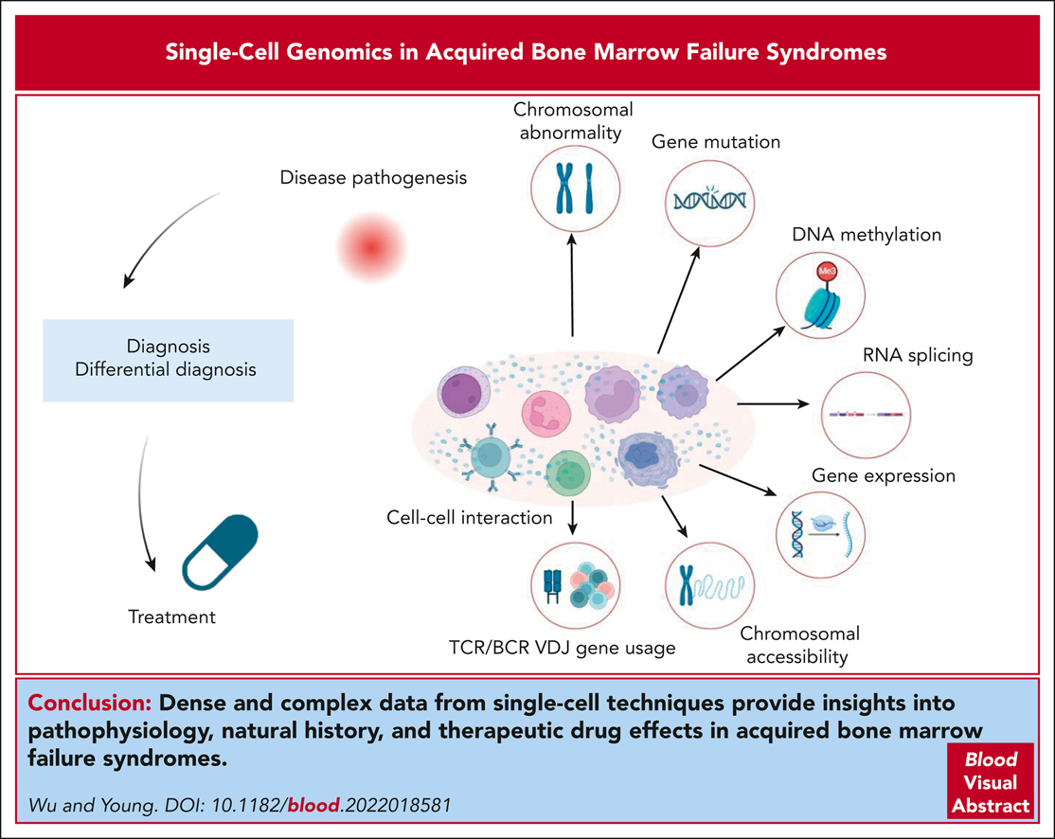

Single-cell genomics in acquired bone marrow failure syndromes
Zhijie Wu,Neal S. Young, Single-cell genomics in acquired bone marrow failure syndromes, Blood, 2023,
Copyright © 2023 American Society of Hematology
Notes:
Blood Review Article

Slide 5
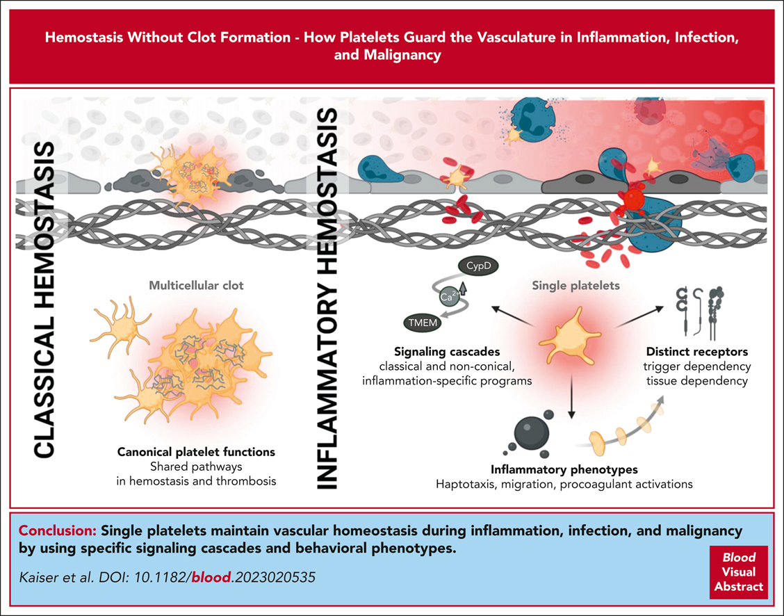
Hemostasis without clot formation: how platelets guard the vasculature in inflammation, infection, and malignancy
Rainer Kaiser,Raphael Escaig,Leo Nicolai, Hemostasis without clot formation: how platelets guard the vasculature in inflammation, infection, and malignancy, Blood, 2023,
Copyright © 2023 American Society of Hematology
Notes:
Blood Review Article

Slide 6
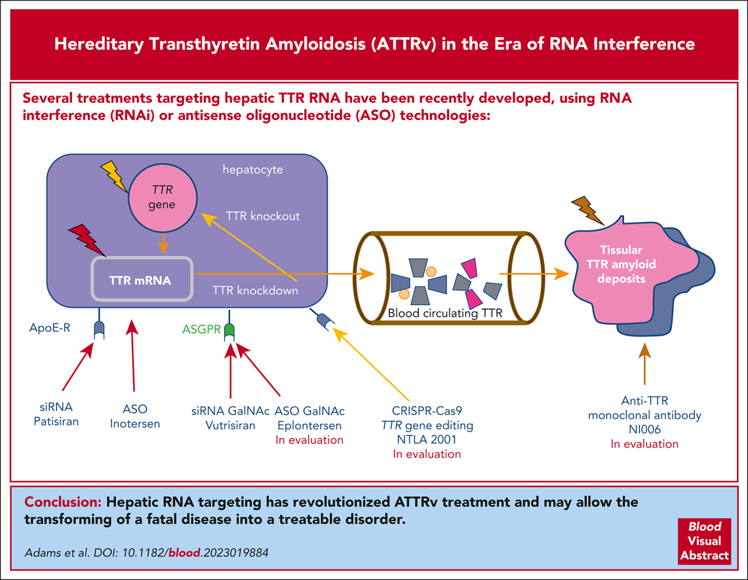
Hereditary transthyretin amyloidosis in the era of RNA interference, antisense oligonucleotide, and CRISPR-Cas9 treatments
David Adams,Vincent Algalarrondo,Andoni Echaniz-Laguna, Hereditary transthyretin amyloidosis in the era of RNA interference, antisense oligonucleotide, and CRISPR-Cas9 treatments, Blood, 2023,
Copyright © 2023 American Society of Hematology
Notes:
Blood Review Article

